Slide 1
Introduction to Computer Programming Lecture 9.1:
Writing Programs: Guessing Games
Hemma Philamore
Department of Engineering Mathematics

Slide 2
Introduction to Computer Programming Lecture 9.1.a:
Number Guessing Game
Hemma Philamore
Department of Engineering Mathematics

Slide 3
Number guessing game
"I think of a number and you have to guess it"

Slide 4
Start
Number of guesses
Correct guess
﻿Randomly select a number
﻿﻿Initialize game state variables
﻿Main game loop
﻿Get player's next number guess
﻿﻿Clue: Number too high
﻿﻿Clue: Number too low
﻿Guessed
correctly?
NO
NO
YES
Guessed number too small?
﻿+1 number of guesses
YES
﻿Finish game

Slide 5
Introduction to Computer Programming Lecture 9.1.b:
Word Guessing Game
Hemma Philamore
Department of Engineering Mathematics

Slide 6
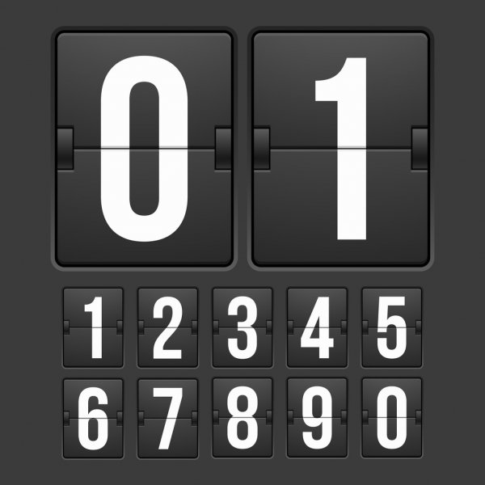
Word guessing game
"I think of a word and you have to guess it"
Wrong guesses
Remaining letters
Word: PYTHON
P_TH _ _
ABCDEFGHIJKLMNOPQRSTUVWXYZ
A
E
B
Remaining tries

Slide 7
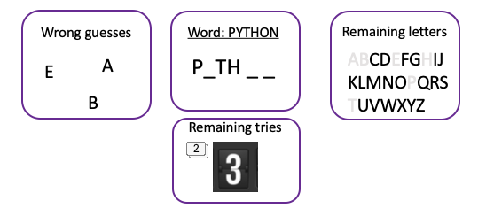
Start
﻿Let player specify no of tries
﻿Randomly select a word
﻿﻿Initialize game state variables
﻿Main game loop
﻿Get player's next letter guess
NO
NO
﻿﻿Check if letter guess is in word
﻿Guessed
correctly?
YES
﻿Word completely
solved?
NO
﻿Number of tries exhausted?
﻿-1 number of tries
YES
YES
﻿Finish game

Slide 8
Introduction to Computer Programming Lecture 9.1.c:
Word Guessing Game: Updating the Current Status
Hemma Philamore
Department of Engineering Mathematics

Slide 9
Start
﻿Let player specify no of tries
﻿Randomly select a word
﻿﻿Initialize game state variables
﻿Main game loop
﻿﻿Print current game state
﻿Get player's next letter guess
NO
NO
﻿﻿Check if letter guess is in word
﻿Guessed
correctly?
YES
﻿Word completely
solved?
NO
﻿Number of tries exhausted?
﻿-1 number of tries
YES
YES
﻿Finish game

Slide 10
To write a program...
Draw flow diagram of what the program should do
Variables needed to define task
join
f strings : print( f”text is {variable}” )
Converting user input : int(input(“Question : ))
input(“Question : ).lower()

